Slide 1

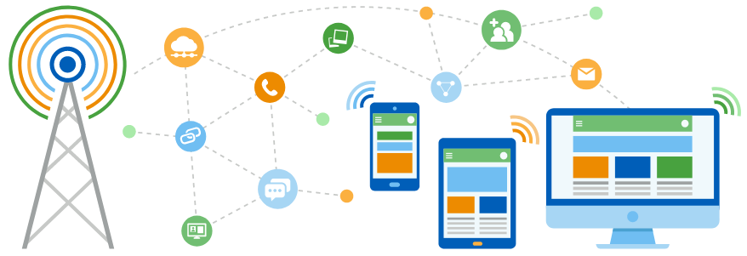
Faculty of Computing and Informatics
Department of Computer Science
IT Infrastructure Administration and Services
ITA711S
2023 - Semester 1
Event Specific Picture – behind red graphic
Chapter 5
Distributed File Services

Slide 2
Outline
Introduction
File Systems
Distributed File Systems
  Network File System
  SAMBA

Slide 3
Introduction
File system
  A file system is a subsystem of the operating system that performs file management activities such as organization, storing, retrieval, naming, sharing, and protection of files.
  File systems enable users to read, manipulate and organize data.
  Without a file system, stored information would not be isolated into individual files and would be difficult to identify and retrieve.
  File systems can differ between operating systems, such as Windows, MacOS and Linux-based systems.
  Some file systems are designed for specific applications.

Slide 4
File Systems
Examples of file systems:
  FAT (File Allocation Table);
  NTFS (New Technology File Systems);
  EXT2/EXT3/EXT4 (Extended file system);
  APFS (Apple File System);
  HFS (Hierarchical File Systems);
  GFS (Global File System);
  XFS;
  F2FS
Find out which file systems are used by Windows, MacOS and UNIX/Linux.

Slide 5
Introduction
A distributed file system (DFS) is a method of storing and accessing files based in a client/server architecture. In a distributed file system, one or more central servers store files that can be accessed, with proper authorization rights, by any number of remote clients in the network.
DFS have been developed to share file systems across a network across different platforms.
UNIX and Windows have the most preferred file systems, with windows having the upper hand, but UNIX/LINUX slowly coming through with its solid secure systems.

Slide 6
Distributed File System
Files contain both data and attributes.
The data consist of a sequence of data items accessible by operations to read and write any portion of the sequence.
The attributes are held as a single record containing information such as the length of the file, timestamps, file type, owner’s identity and access control lists.

Slide 7
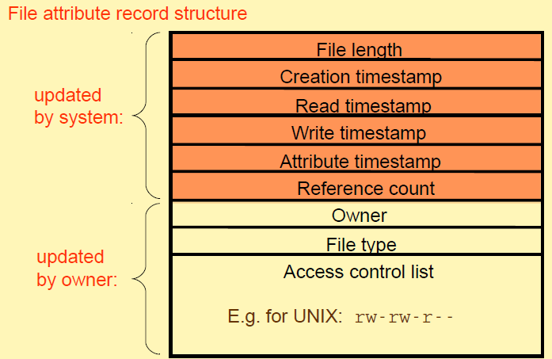
Distributed File System

Slide 8
Journaling in DFS
Journaling means keeping track of changes which are not yet committed to the file system’s main part, by recording such changes in a data structure known as a “journal”.
A journal can be used as a checkpoint. A checkpoint is a summarization of all records that were written to the file, and presents a consistent state of the DFS.
When any fault appears, the DFS can recover by returning to this checkpoint by applying changes which are stored in the journal.
Journal and checkpoint serve for maintaining metadata information.
In an even of a system crash or power failure, a journaling file system can be brought back online more quickly with a lower chance of being corrupted.

Slide 9
Distributed File System
Examples:
  Network File System (NFS)
  Samba (SMB)
  Lightweight Directory Access Protocol (LDAP)
  Distributed Computing Environment (DCE)
  Andrew File System (AFS)
  COnstant Data Availability (CODA)
  Common Internet File System (CIFS)

Slide 10
Network File System (NFS)
An internet protocol which was originally created by Sun Microsystems in 1980s, and was designed for mounting disk partitions located on remote computers.
Enables file systems on one host system to be used by another on the network, appearing just as another disk. It is available in UNIX systems.
NFS was developed to allow machines to mount a disk partition on remote machine as if it were on a local hard drive. This allows for fast seamless, sharing of files across a network.

Slide 11
Network File System (NFS)
NFS was made for making client unaware of location of their files.
NFS remote file system can be mounted into local directory structure. Clients can then work with their files as if the files were stored on their local file system.
On server side, NFS uses the same directory structure as is shown after mounting to the client.

Slide 12
NFS Architecture components (Linux/UNIX)
Server:
  nfsd: NFS server daemon that services requests from clients.
  mountd: NFS mount daemon that carries out the mount request passed on by nfsd.
  rpcbind: RPC port mapper used to locate the nfsd daemon.
  /etc/exports: configuration file that defines which portion of the file systems are exported through NFS and how.
Client:
  mount: standard file system mount command.
  /etc/fstab: file system table file. Remote file systems are added/mounted into this file.
  nfsiod: (optional) local asynchronous NFS I/O server.
NSF sharing options
  rw, ro, sync, async, root_squash, no_root_squash, wdelay

Slide 13
NFS Mount Service
Mount operation:
  mount(remotehost, remotedirectory, localdirectory)
Server maintains a table of clients who have mounted file systems at that server.
Each client maintains a table of mounted file systems.

Slide 14
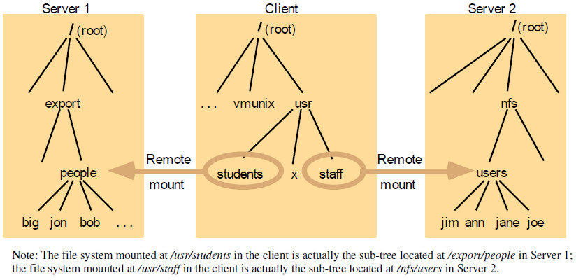
Local and remote file systems accessible on an NFS client

Slide 15
Samba
Samba was developed in 1980s by IBM as a protocol for sharing files and printers.
A network file system allows for sharing the contents of directories or entire drives across a network.
Samba implements the SMB protocol which is what allows Windows clients to transparently access Linux directories, printers and files on a Samba server (just as if they were talking to a Windows server).
Samba allows for a Linux server to act as a Domain Controller. By doing so, user credentials on the Windows domain can be used instead of needing to be recreated and then manually kept in sync on the Linux server.

Slide 16
Samba
Connecting to a Windows Host from Linux
  Connect to a server, and select windows share to enable SMB.
  Note!! Hosts should be able to communicate before connection
SAMBA allows UNIX file systems to be shared with Windows Systems
  Samba uses SMB (Server Message Block) protocol, that makes UNIX file systems look like windows shared files.
  Samba is an open source package that provides file and printer sharing for Ms Windows clients
    Samba has the following /etc/smb.conf file, or some the /etc/samba/smb.conf
    Samba service can be enabled by locating samba file, then ./samba start.
    Whenever you are configuring the smb.conf file you will need to stop and start samba for effects to kick in.

Slide 17
Samba
Two of the most important settings in the smb.conf
Security model
  Two options
  security = share
    Clients do not need to log onto the server with a valid username and password.
  security = user
    If clients use the same usernames as their own host logon
Backend password format

Slide 18
SAMBA
Backend password format
  Several authentication models, e.g. LDAP, NIS etc…
  Default authentication is ‘smbpasswd’
  smbpasswd is a duplicate of the passwd file, Samba uses this file to authenticate clients.
  Note:!! You have to enable smb passwords for the users, using the command #smbpasswd –a username

Slide 19
Configuring samba
Create a directory on the server to hold your shared files and folders.
To configure shares and users, edit the /etc/samba/smb.conf file
The global section defines a workgroup:
[global]
  workgroup = ITA711S
  security = user

Slide 20
Configuring samba
Creating a shared location, still editing the /etc/samba/smb.conf file
Users logging into a Samba share must either have accounts on the server or log in as a guest.
[public]
  comment = Public Staff
  path = /home/share
  public = yes
  writable = yes
  printable = no
  read only = yes
  write list = +staff

Slide 21
FDS (Share)
Example share in smb.conf
[homes]
  comment = Home Directories
  browseable = no
  writable = yes

Slide 22

End

